Slide 1
Introduction to MLib

Slide 2
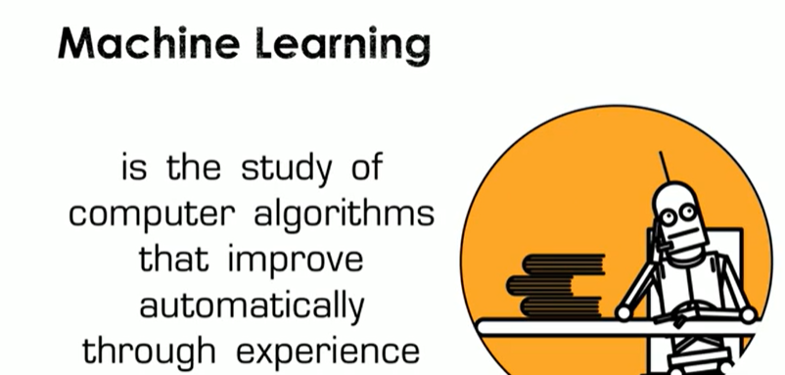

Slide 3
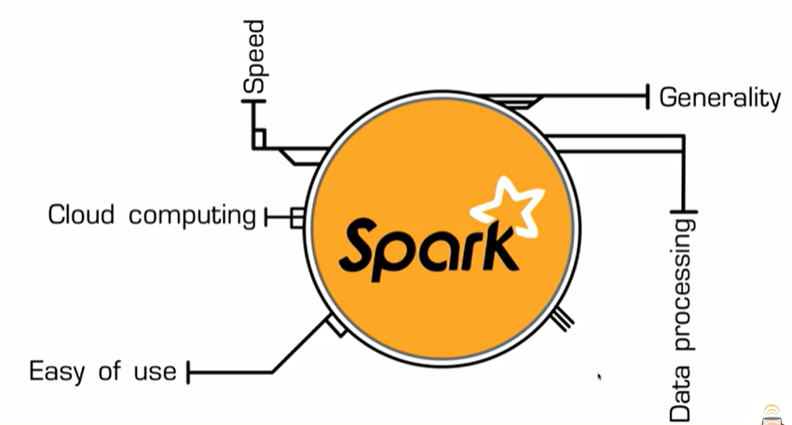
Apache Spark as a popular big data project, focusing specifically on its machine learning library, MLlib

Slide 4
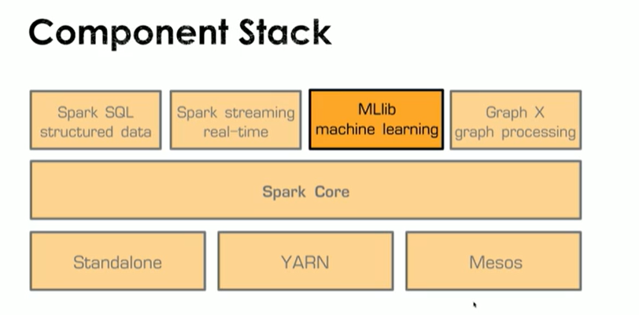
MLlib is designed to run machine learning algorithms in parallel across clusters, providing built-in abstractions that simplify implementation, such as avoiding manual coding of gradient descent.
The library is part of the Spark ecosystem and offers utilities and algorithms out of the box.

Slide 5
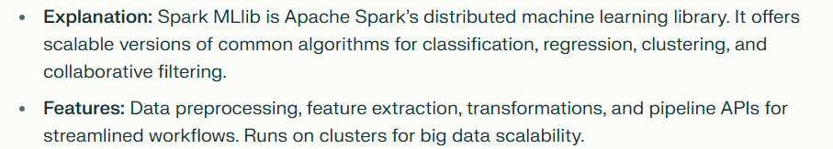
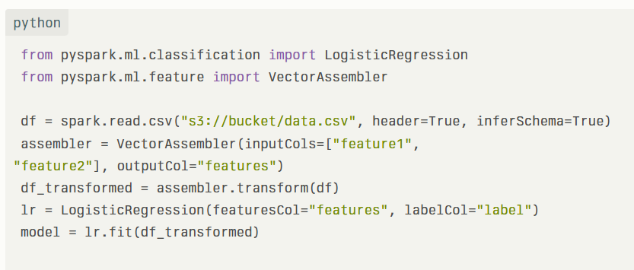
Overview of Spark MLlib

Slide 6
Contd….
MLlib introduces new data types like vectors and labeled points to represent training examples, using Spark abstractions such as RDDs and datasets for distributed processing.
There are two major Spark ML packages: the older MLlib based on RDDs, and the newer SparkML built on datasets, which includes utilities for linear algebra, statistics, feature extraction, transformation, and common machine learning algorithms like regression, classification, and clustering.
SparkML offers many features including feature transformations like text vectorization and vector normalization, along with various algorithms such as collaborative filtering and dimensionality reduction.
parkML for adopting pipeline concepts inspired by Python’s scikit-learn, allowing users to structure machine learning workflows, persist models, and reuse them

Slide 7
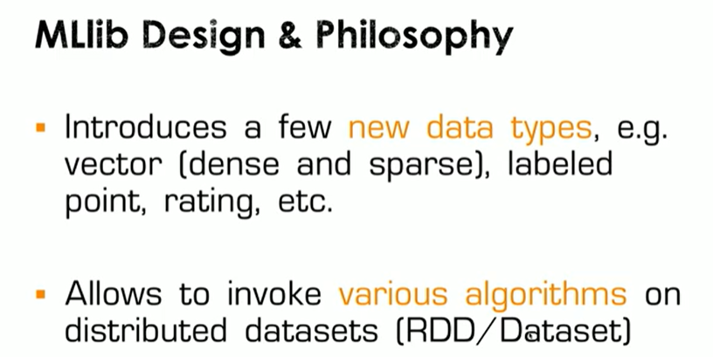
SparkML supports advanced functionalities like model selection and tuning with techniques such as k-fold cross-validation, automating data splitting and evaluation metrics.
he typical workflow involves transforming raw data using Spark abstractions, applying estimators for intermediate and final models, and using a cross-validator to optimize parameters, thereby simplifying machine learning model training and evaluation.

Slide 8
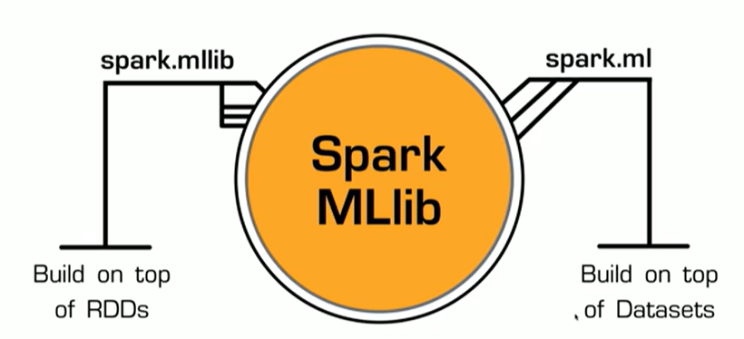

Slide 9
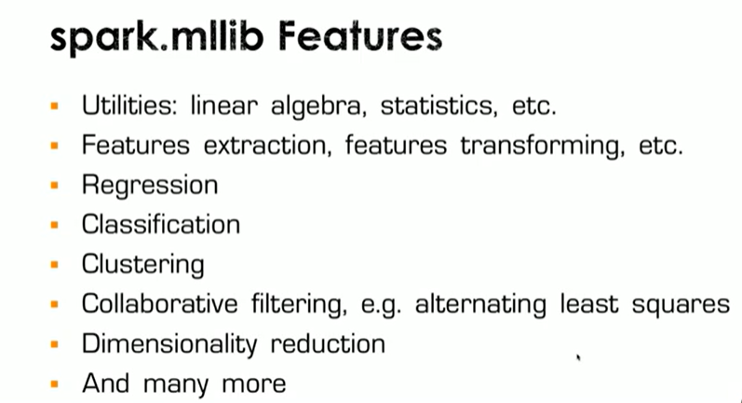

Slide 10
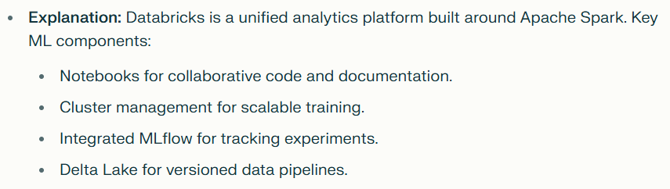
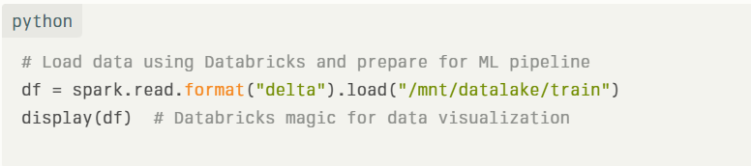
Key Components in Databricks

Slide 11
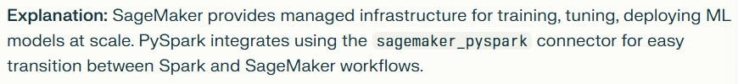
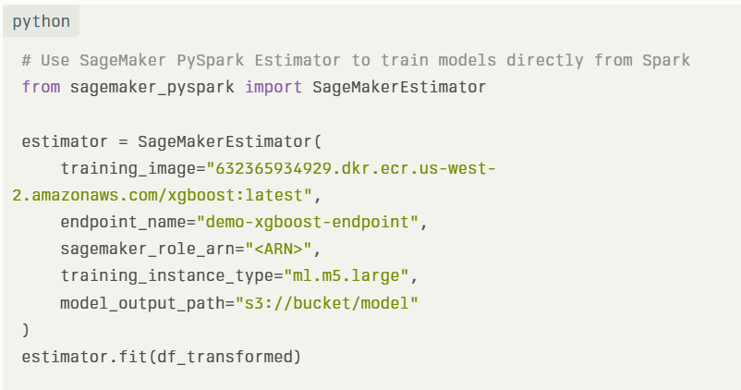
Amazon SageMaker Integration

Slide 12
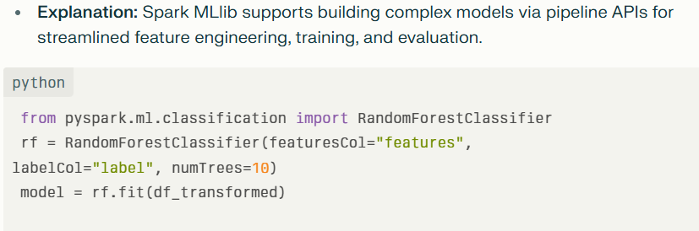
Building ML Models with PySpark

Slide 13
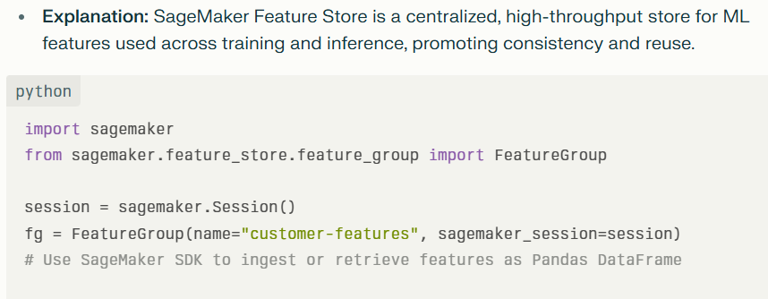
SageMaker Feature Store

Slide 14
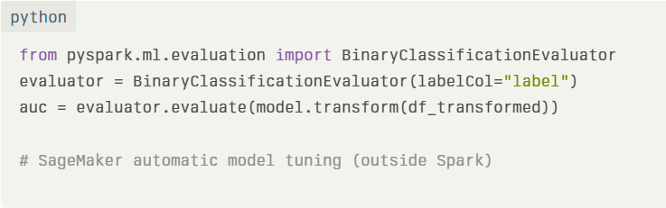
Integration – Model Evaluation and Tuning
Evaluate model with Spark MLlib metrics or SageMaker’s built-in tuners. Cross-validation for selection and hyperparameter optimization.

Slide 15
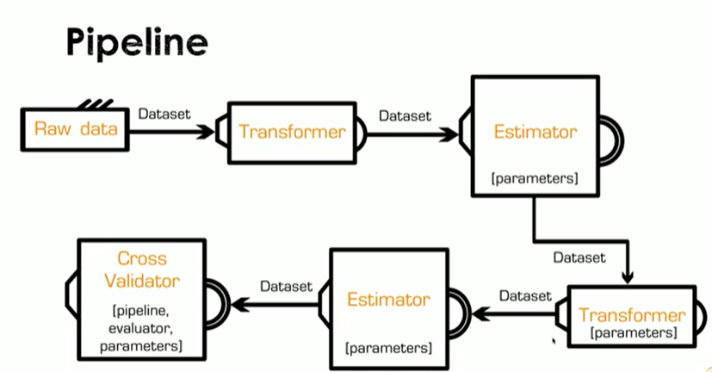

Slide 16
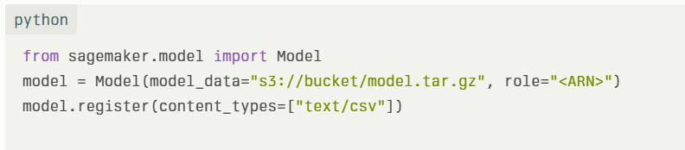
SageMaker Model Registry
A place to store, approve, version, and deploy models for CI/CD. Ensures traceability and streamlined promotion to production.

Slide 17
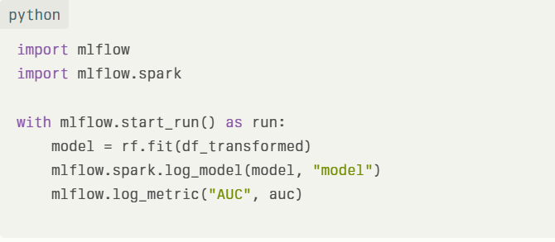
MLflow Integration - Tracking Experiments and Models
MLflow integrated into Databricks and SageMaker for tracking, versioning, and deploying ML models automatically. Logs parameters, code versions, metrics, and artifacts centrally.

Slide 18
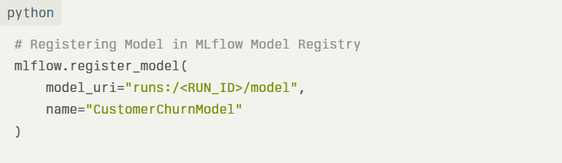
Model Versioning and Deployment
MLflow Model Registry manages multiple versions and lifecycles. Models can be programmatically promoted and deployed to SageMaker Endpoints or Databricks serving

Slide 19
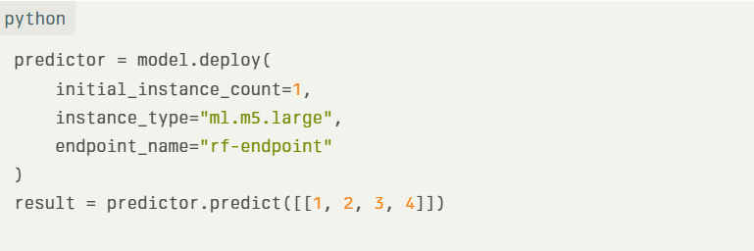
SageMaker Endpoints for Model Serving
Deploy trained and registered models from SageMaker Model Registry or MLflow directly to scalable SageMaker endpoints for real-time prediction.

Slide 20

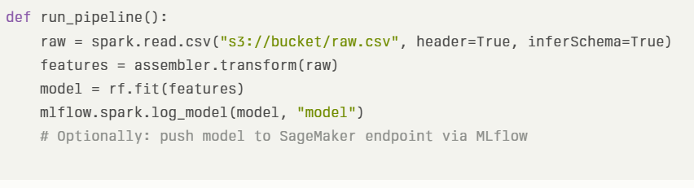
Pipeline Automation with Python Scripts

Slide 21
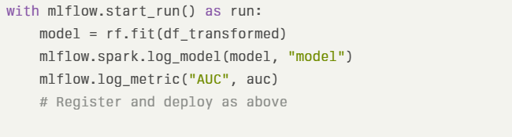
Sample Output and Demo
Training and logging a model with MLflow, registering to registry, and deploying to SageMaker.

Slide 22
Advantages:-
Scalability: Designed to handle large-scale data across distributed clusters.
Speed: Leverages in-memory computation in Spark, faster than traditional MapReduce-based ML.
Integration: Works well with other Spark components (SQL, Streaming, GraphX, etc.).
Ease of Use: Offers high-level APIs in Java, Scala, Python (PySpark), and R.
Distributed Algorithms: Supports ML algorithms optimized for parallel computation (e.g., linear regression, k-means).
Pipeline API: Provides DataFrame-based ML pipelines similar to scikit-learn for building reusable workflows.
Compatibility with Spark DataFrames: Enables seamless data preprocessing using Spark SQL/DataFrames.

Slide 23
Disadvantages
Limited Algorithms: Supports fewer algorithms compared to libraries like scikit-learn, TensorFlow, or PyTorch.
Lacks Deep Learning: No native support for deep learning models (though it can integrate with TensorFlow/Keras via third-party libraries).
Performance Overhead: Overhead in cluster setup and coordination for small datasets or simpler tasks.
Slower Iteration: Model training and tuning can be slower than non-distributed libraries for small or medium data.
Transition from RDD to DataFrame-based APIs: Confusion due to two APIs (RDD-based mlib and DataFrame-based ml.) The RDD API is now in maintainance mode.

Slide 24
Use Cases
Customer segmentation using K-Means on big datasets.
Product/movie recommendations using ALS (Alternating Least Squares).
Identifying fraud or system failures in logs using clustering or classification.
End-to-end ETL and model training using Spark SQL + MLlib in a single pipeline.

